Slide 1

GROUP 1
BURGER QUEEN ONLINE SYSTEM

Slide 2
DISCLAIMER
Do not look on the author of the GIT.

Slide 3
GOALS on creating the Project
Apply knowledge taught
Spring MVC (RESTFul ,log4j etc.)
Oracle
Ext JS (Sencha , Version 4.2)
Filter (certain names) and Listeners (Active Users and Session)
JDBC Template
JTA (Java Transaction API)
Apply basic functions of an online ordering system.

Slide 4
Project Approach
1. Brainstorm
We plan our MVP (Most valuable product) to deliver
Make sure we clear the scope of our system
We talk about on some nice to have feature in our project.
2. Recycle what we can recycle on our last project.
DAO, Impl , Filter, Listener, SQL Scripts and design
Homeworks (JDBCTemplate and JTA)

Slide 5
Task Allocation
Peter Barredo – Initial body of Spring Project with initial transaction in DB.
UI
Pauline Joyce Racelis
John Paul Limos
Ana Katrina De Leon
DOM
Mark Anthony Andes – Tester (Functional and Black tester)
Aljun Dequilla

Slide 6
SCOPE and DELIMITATION
SCOPE
CRUD tray of the user’s orders
Browse products
Basic validations (login and registration)
Can block blocked users
Can display active users
It can search products
Has incorporated log4j
DELIMITATION
The items in the cart will be removed after the user logged out of the system.
No paging
No Spring Validator
Other approach for filter
No JUNIT

Slide 7
PLAN
ACTUAL
Friday
Exploration
Initialize Project with JDBC Template and JTA
Mock-up UI in Ext JS
Saturday
Integration of UI
Finish All controller service (MVP)
Finish all UI page (Transitions and Behavior)(MVP)
By Saturday the project (MVP) status is finished
Sunday
Testing (functional testing and User Testing)
Apply nice to have features (admin, etc )
REST ☺
Friday
Exploration
Initialize Project with JDBC Template and JTA
Mock-up UI in Ext JS
Saturday
Integration of UI (BLOCKER)
Finish All controller service (MVP)
Finish all UI page (Transitions and Behavior)(MVP)
Sunday
Finish all controller service (MVP)
Finish all UI page (Transitions and Behavior)(MVP)
Testing (Functional testing and User Testing)
No rest ☹

Slide 8
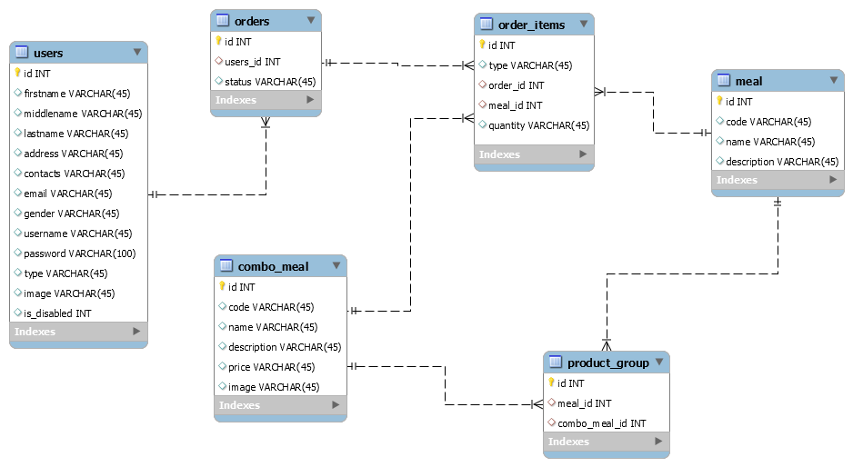
SQL Planned

